Slide 1
Introduction to Database Systems
Notes:
Today we will open the main topic of this class, which is databases. Before we start talking about databases do you have any questions about what we have done so far? Do you have any questions about the homework?
In todays world, databases are used practically in every system. Pretty much any website is built up on top of a database. All organizations (banks, hospitals, universities etc) have their own databases. So we will start with the definition. Anyone want to try? What is the first thing that comes in mind when you hear the word “database”?

Slide 2
Why do we need databases?
Can you think of problems that you might face if you store information in text files?

Slide 3
Databases vs. Text Files
When should you use a database instead of a text file?
Data Consistency: Restrict types of values that can be entered in each column (date vs. age vs. salary vs…)
Being able to sort by column and look for pieces of information
Easier to analyze the data (e.g., a pie chart on how well each book is selling…)
Notes:
Being able to sort by column
Restrict types of values that can be entered in each column (date vs. age vs. salary vs…)
Easier to analyze the data (e.g., a pie chart on how well each book is selling…)
Natural question: Why not Excel then???

Slide 4
Databases vs. Spreadsheets
When should you use a database instead of Excel?
Insertion anomalies
Deletion anomalies
Update anomalies
Notes:
Talk about the anomalies
Then show how to organize in separate tables

Slide 5
Anomalies in un-normalized data
Insertion anomalies
Inability to insert a piece of information about an object without having to insert a (bogus) piece of information about something else
Example: Adding a new customer/book before it is ordered How can you add the book “Harry Potter” in the file below?
Notes:
Go through the table in the previous slide and find the problems encountered when one wants to insert, delete, or update data in it.
Talk about Anomalies
Write down an example of one anomaly (individual then consult pairs).

Slide 6
Anomalies in un-normalized data
Deletion anomalies
The loss of a piece of information about one object when a piece of information about a different object is deleted
Example: Deleting order 2 => deleting customer Lee Sproull
Example: Deleting order 1 => deleting book “Code…”
Notes:
Go through the table in the previous slide and find the problems encountered when one wants to insert, delete, or update data in it.
Talk about Anomalies
Write down an example of one anomaly (individual then consult pairs).

Slide 7
Anomalies in un-normalized data
Update anomalies
Need to change multiple times the same piece of information about an object
Example: Changing Jeff Bezos address in order 1 leaves orders 6 and 8 unchanged…
Notes:
Go through the table in the previous slide and find the problems encountered when one wants to insert, delete, or update data in it.
Talk about Anomalies
Write down an example of one anomaly (individual then consult pairs).

Slide 8
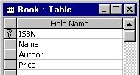
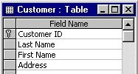
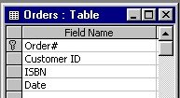
A normalized version of the database
Normalization
The process of assuring that a database can be implemented effectively as a set of two-dimensional tables
Prevents insertion, deletion and update anomalies
Notes:
Go through the table in the previous slide and find the problems encountered when one wants to insert, delete, or update data in it.
Talk about Anomalies
Write down an example of one anomaly (individual then consult pairs).

Slide 9
Connecting tables together
Primary keys
A field (or group of fields in some cases) that uniquely describes each record in a table
Examples: Customer ID, ISBN, Order#
Each record should have
a unique primary key
Foreign keys
A field that is a primary key in one table and appears in a different table (though not as the primary key)
Examples: Customer ID in Orders
Integrity constraints
Rules that help ensure data quality

Slide 10
Database schema
Summary of the logical structure of your database
The tables in your database, along with each of their fields, keys
The relationships between the tables
Primary key
Primary key
Primary key
Foreign key
Foreign key

Slide 11
Entity Relationship Diagrams (ERD)
Notes:
Now we will move forward and discuss the entity relationship diagram, which is a methodology that help us understand what data we have, and what is the best way to structure our database.

Slide 12

ERD: Introduction (0:00 – 2:40)
Notes:
We will discuss about rows and tables in the next class, when we will talk about the relational model.

Slide 13
Database Development process
Problem
(e.g., Manage student registration)
Requirement Analysis
Requirement Specification
Natural
Language
Conceptual Data Modeling
Conceptual
Model (ERD)
Diagrams
Logical Design
Relational
Model
Formal
Statements
Physical Design
Database

Slide 14
ERD: Entities (2:40 – 4:00)
Notes:
We will discuss about rows and tables in the next class, when we will talk about the relational model.

Slide 15

Entities
An entity is a collection of objects with the same properties:
Students (student name, student id, age, sex, etc. )
Courses (course id, section id, course description, location, etc..)
Attributes
Entities are description of instances:
An instance of entity “Students” might be: (“Joe Doe”, “N12897”, “20”, “M”, etc.)
An instance of entity “Courses” might be: (“Ub401”, “002”,“Dealing with Data” , “KMC-575”, etc.)
Notes:
Stop at 4 minutes.

Slide 16
ERD: Primary Keys (4:00 – 4:55)

Slide 17
Primary Key (PK)
An attribute whose value is unique in each instance:
Student id in the students entity
Composite primary key: A primary key that consists of two or more attributes, whose values together (but not separately) are unique for each instance in an entity:
Course id and section id in the courses entity

Slide 18
Why do we need PKs?
Identify each instance uniquely (ability to retrieve)
Refer to instances of other entities
Fast Retrieval (indexing)
Notes:
To identify each instance uniquely, and be able to retrieve it
DBMS create indexes and other structures on these keys which allow them to fast retrieve the instances that they need, when queried at the primary key (very fast)
If one entity wants to refer to instances of another entity, the fit will do it by referring to these instances w.r.t their PK values.

Slide 19
Entity Representation
Students
Attributes
Primary Key
Student Id
Student name
Age
Sex
Entity Name
Courses
Composite
Primary Key
Course Id
Section Id
Course Description
Location
Attributes

Slide 20
ERD: Relationships (4:55 – 5:55)
Notes:
At 5:00 starts relationship.

Slide 21
Relationship
A relationship is an association among entities:
Students take courses (take is a relationship)
Students
Courses
Student Id
Student name Age
Sex
Take
Course Id
Section Id
Course Description
Location

Slide 22
Representation of Relationships
A relationship is shown as a line connecting the associated entities, labeled with the name of the relationship
A relationship name is usually a verb (e.g., takes)
Whenever possible, a relationship name should be unique
A relationship has implied direction
Notes:
So far, we have defined entities, relationships, and primary keys. Once again, entities are collections of objects with the same properties, relationships capture the associations between different entities, and primary keys are used to uniquely identify entity instances

Slide 23
ERD: Cardinalities (5:55 – 9:12)
Notes:
At 5:45 starts relationship.

Slide 24
Cardinalities
Cardinalities describe the number of instances that participate in a relationship
Courses
Course 1
Course 2
Course 3
Course 4
Studentss
Student 1
Student 2
Student 3
A student can take 0,1, 2, or more courses (many). A course can be taken by 0,1,2 or more students (many). This example, has a
many to many cardinality.
Notes:
For example, assume that we have these two entities, Students and courses. A student can take 0, 1, 2 or more courses,

Slide 25
Cardinality Notation
Symbol | Meaning
 | One - mandatory
 | Many - mandatory
 | One - optional
 | Many - optional

Slide 26
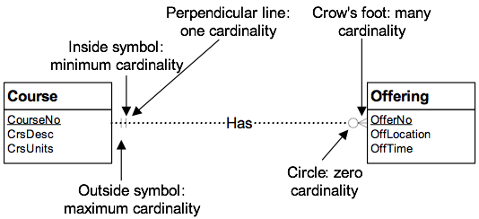
Cardinality Notation Example
Notes:
Here is another example, where we have two entities, the course enticing with attributes…and the offering entity with ….and the relationship that shows that a course has an offering (or is offered) we can see the cardinality represntation,

Slide 27
Examples of Cardinality Signs
Exactly-one ( || ), i.e. there must be exactly 1 relationship. e.g., a professor must have exactly 1 office.
One-to-many ( | ). e.g., each department has many instructors (but at least one!)
Zero-to-many ( ). e.g., each student can have several cars (but sometimes they don’t have any!)

Slide 28
One-to-one Relationships
Student
StudentAccount
| |
Owns
0 |
studentID
userID
Cardinality
The maximum number involved in a 1 to 1 relationship is one
Each student can own zero or one (expressed as “0 |”) account and each account is owned by exactly one (expressed as “||”) student

Slide 29
One-to-many Relationships
Department
| |
Has
|
Professor
DeptNo
ProfID
Cardinality
One-to-many , e.g., each department has many professors:
Each department can have one or more (expressed as “ | ”) professors and each professor is affiliated with one and only one (expressed as “| |”) department.

Slide 30
Many-to-Many Relationships
Students
Courses
Student Id
Student name Age
Sex
Take
Course Id
Section Id
Course Description
Location
Many-to-many, e.g., many students take many courses:
Each student can take 1 or more courses and each course can enroll many students.

Slide 31
ERD: Bridge Entity (10:12 – 11:00)
Notes:
At 7:40 starts Business rules.

Slide 32
Bridge Entity
Any time you have a many to many relationship, you will need to create a bridge entity:
Students
Registration
Courses
Student Id
Student name Age
Sex
Student Id
Course Id
Section Id
Course Id
Section Id
Course Description
Location
Notes:
The problem is in the implementation phase (we will come back to this later) but in general, it will create redundant data.

Slide 33
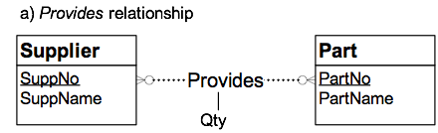
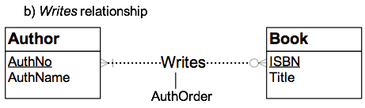
Relationships can also have attributes
Student
Course
Takes
courseNo
studentID
sectionNo
registrationDate

Slide 34
ERD: Quiz Questions (11:40 - …)
Notes:
At 7:40 starts Business rules.

Slide 35
Create the following ERDs
A painter can paint many paintings; each painting is painted by one painter. A gallery can have many paintings. A painting can be exhibited by a gallery.
An employee can learn many skills; each skill can be learned by many employees. There are 5 different levels of expertise(L1.. L5).

Slide 36
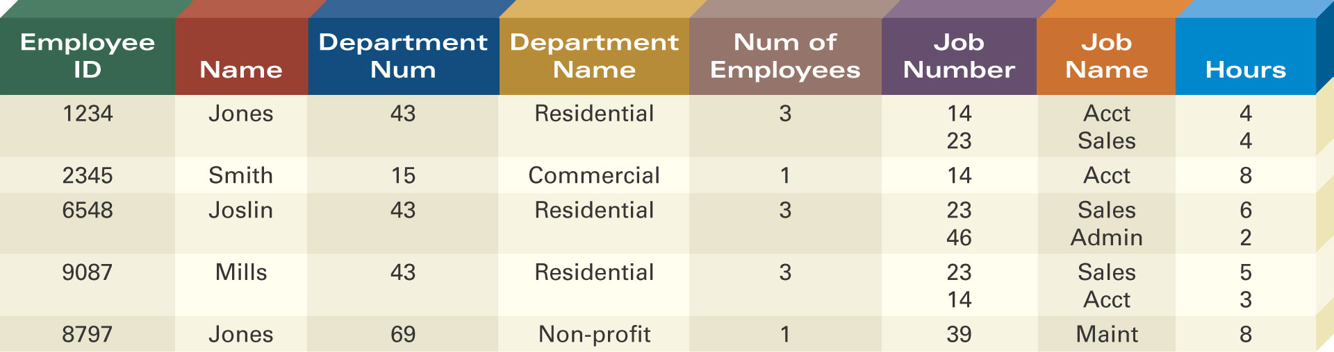
Defining Entity Classes and Primary Keys
What are the entity classes and primary keys for the report below?
What entities/tables should we create?
Are there fields that are redundant once you create the tables?

